Slide 1

My Family, My Rights!
Developing a new rights-based programme for families affected by substance use

Slide 2
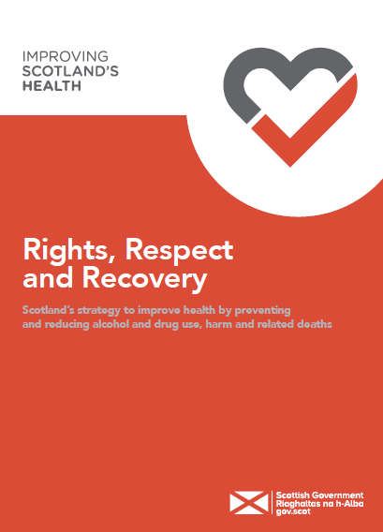
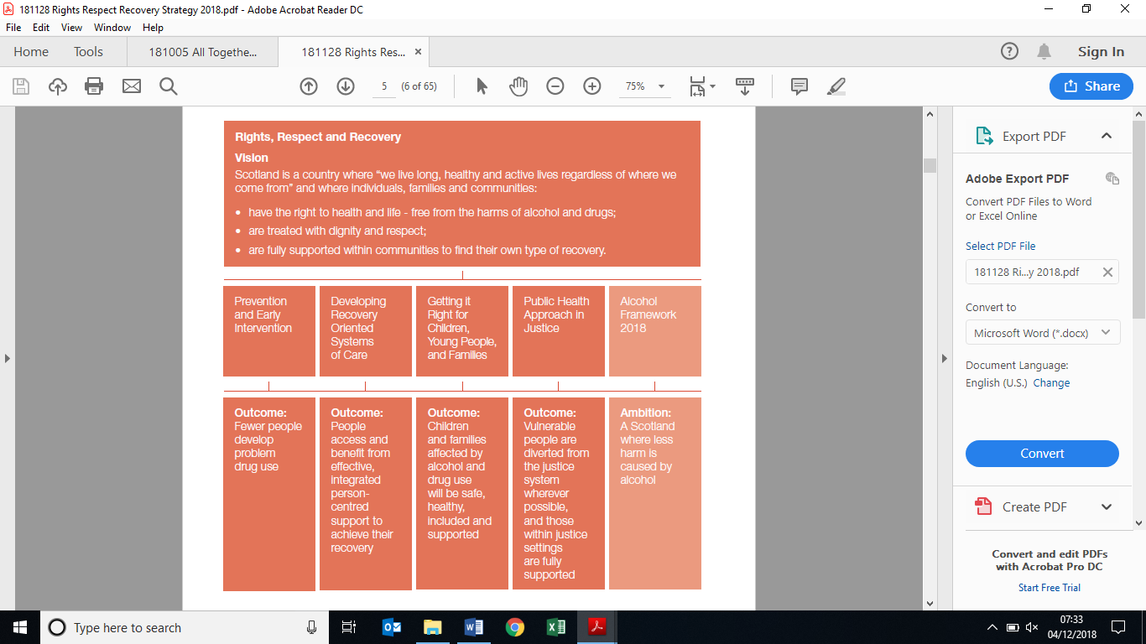


Where it all began
‘Rights, Respect, Recovery’ – and families
@ceosfad
@ScotFamADrugs

Slide 3
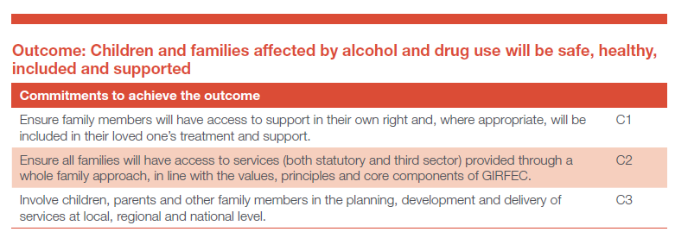
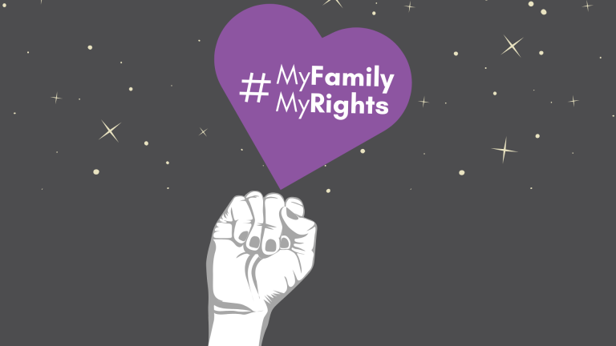
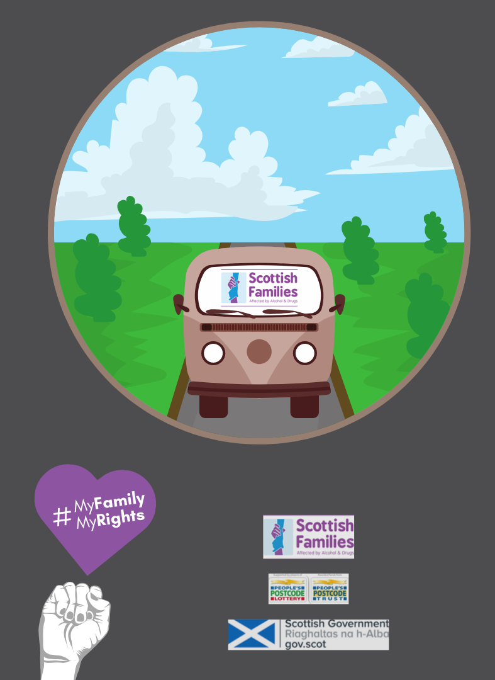
Transformational rights for families
(on paper anyway …)
@ceosfad
@ScotFamADrugs

Slide 4
Families’ experiences
Barriers to physical or informational access
Not being allowed into appointments or allowed contact
Lack of information around loved one
Exclusion from decision-making about loved one’s care
Language jargon
Need for knowledge
Rights and when to use them
Who to contact
Service options
Stigma
Notes:
All of this affects families and can affect loved one’s care

Slide 5
Aim
To inform families of their rights and how to use them, and reduce gap between rights-based policy and practice.

Slide 6






Outcomes
Families are more aware of rights
Families are empowered to use their rights
Families understand loved ones’ rights
Families have the ability to advocate for themselves
Rights feel real for families on the ground
Services uphold families’ rights.

Slide 7

Developing the Course
Created for families, by families
Course advisors with lived experience informed:
  Course topics, format, and times
  Accessibility of course material and activities
  Language
  Use of diverse examples, case studies, and speakers
  Extra hour after session for support and information
Course advisors paid for time and input
“The course advisors being on board wasn’t tokenistic. Because we were prepared as a staff team for people to come in and literally rip it to shreds. We had to have a loose idea of what we thought it would look like because we couldn’t come in with almost nothing but it was totally ripped apart and out back together in the most amazing way.”
-- Gill, Course facilitator

Slide 8





Delivering the Course
Online pilot course lasted for 12 weeks
9-12 attendees each week
Led by Scottish Families course facilitators with contributions by guest speakers with specialist experience
Accompanied by handouts and resources mailed weekly

Slide 9
Weeks 1-4
General Knowledge
Introduction to Advocacy
Empowerment
Cycle of Change
Introduction to Human Rights
Health
Treatment Services
Home + Community Safety
Safeguarding Vulnerable Adults
Weeks 5-10
Specific Topics
Criminal Justice
Carers’ Rights + Self-Advocacy
Weeks 11-12
Case Study
Case Study Week 1
Case Study Week 2

Slide 10

After My Family, My Rights…
By end of course, 60% of attendees had already used course content for advocacy
Surveys provided feedback for:
  Accessibility
  Materials
  Roleplay activities
  and these have informed future courses
One-to-one conversations with course attendees for further feedback and understanding of impact

Slide 11



Building Connections
Knowledge
Stigma

Slide 12
Stigma
The level of stigma and judgement that’s involved in “well they’ve chose to do that”. You know? People don’t choose to ruin their lives, to ruin their family relationships, to turn their backs on their friends and their lives, they don’t choose that. They’re using it as a coping mechanism.
I suppose by doing this course I know that people can say things that they like, but at the end of the day my son and people like him have a right to care, respect, for people to listen to him. And if the time should come where I need to speak up for him or with him, I’m ready to do that.”

Slide 13
Knowledge
But I always think as well it’s so good to have this information because it’s not just for me, because if I was to come across somebody else in a similar situation then I can pass that knowledge to them. So I may not be putting it into practice, it’s always good to have that knowledge that I can then share that with someone who needs it.
Having knowledge of what your rights are gives you confidence and makes you feel that you can speak up.

Slide 14
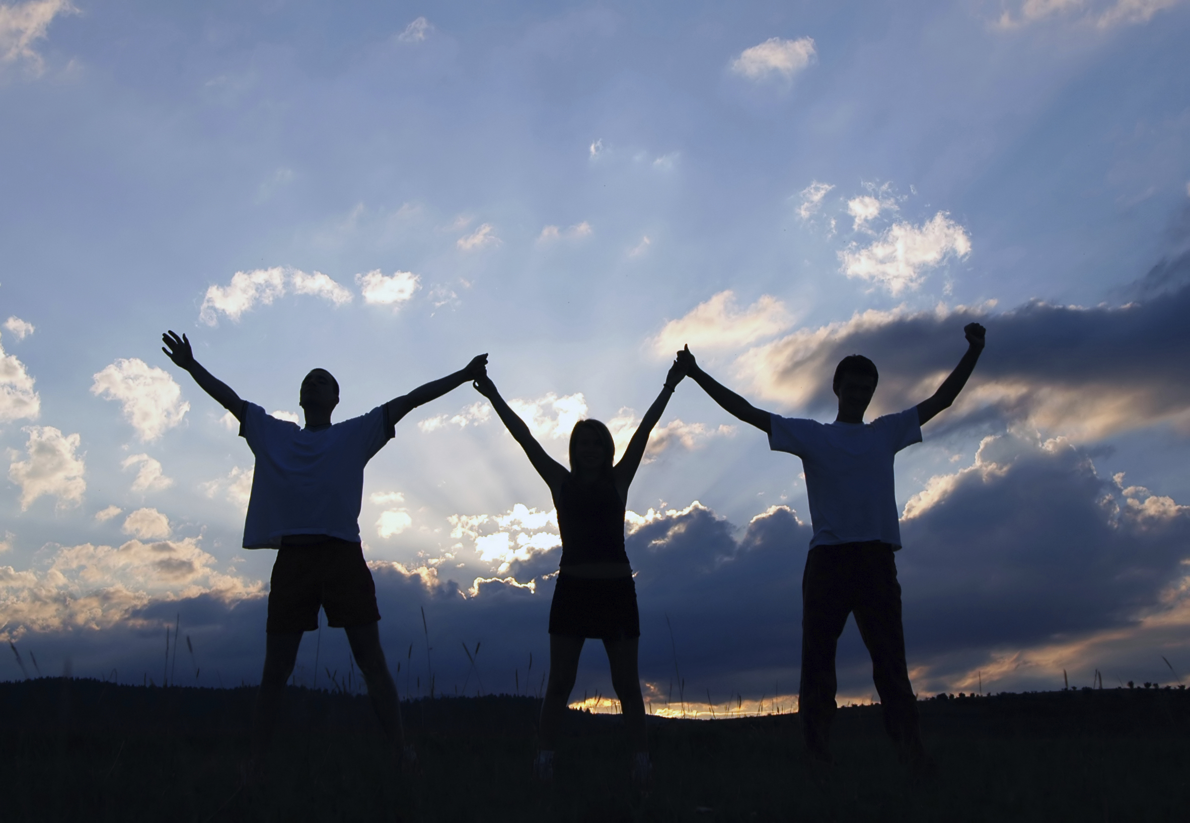
I'm still using the knowledge l gained and quote various acts etc when helping others in my support group and also when fighting for my son's rights. I have used so much, all services are in place unless there is a crisis point and that alone has enabled me to stop enabling him, this has been good for both of us as things get volatile at times, I have been able to speak to service providers and my loved one with so much more knowledge and confidence in what I am saying.

Slide 15
Building Connections
They really created a space for people to talk quite openly and develop quite supportive relationships. Because being in a space where you can talk openly about this stuff it’s really quite important, because it’s so isolating for folk dealing with stuff like this that you just kind of put your head down and stop telling people what’s going on in your life.
Everyone was similar in that we had lots of experience that we could share, whether it was involving police, medical emergencies, services. So we all had that experience in lay terms if you like. I think we all agreed that services can give you the run-around and that we don’t speak their language naturally. So it was perfect for people, to educate them and help them speak up in a more informed way.

Slide 16
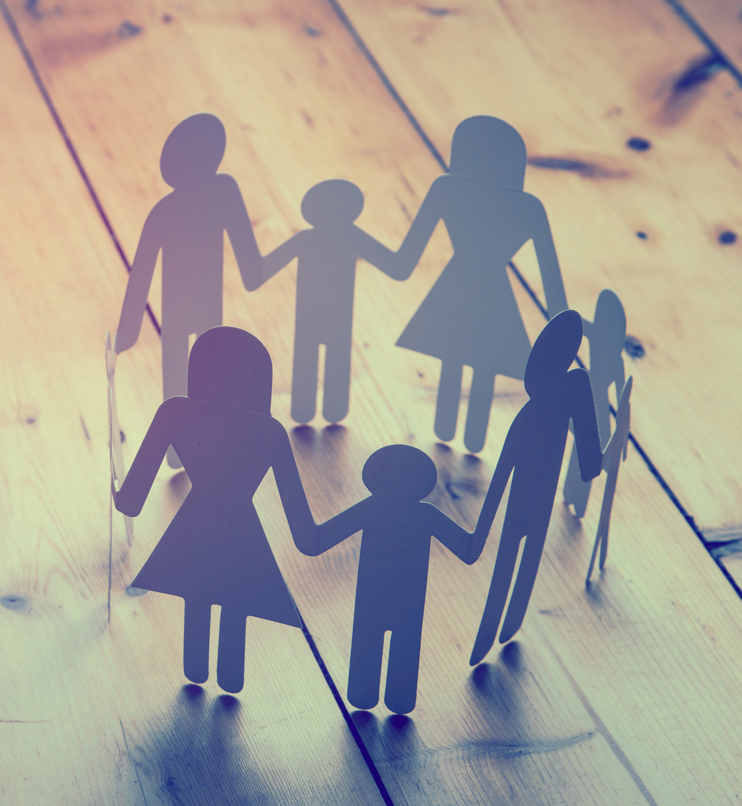
Having that mutual support really rises people up. The information along with the emotional support really has been quite amazing.

Slide 17
Building Connections
Knowledge
Stigma

Slide 18


My Family, My Rights
Connections between family members attending course
Notes:
Knowledge connections between people in MFMR course

Slide 19
My Family, My Rights
Connections between family members and other individuals

Slide 20
My Family, My Rights
Connections between family members and other groups, organisations, or campaigns

Slide 21

My Family, My Rights
Connections between family members and services

Slide 22
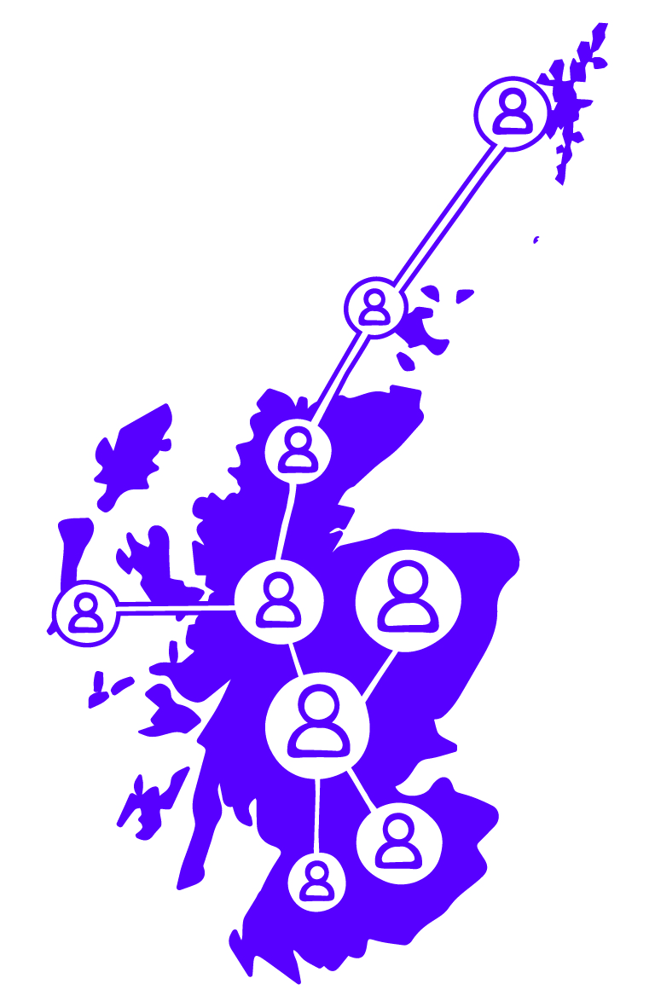
In summary…
Why we developed a rights-based course
How we developed a rights-based course
The impact of a right-based course

